Slide 1
HTML TAGS
MCNDHS
Ms. Eng

Slide 2
AIM: CHANGES TO CONTENT
Do now:
Daily Grade:
On-time/attendance/not leaving the classroom: 25%
Cellphones: 25%
Notes:25%
Classwork/Homework: 25%

Slide 3

LOOK AT THIS DESIGN
Can you determine what the image is trying to advertise?

Slide 4

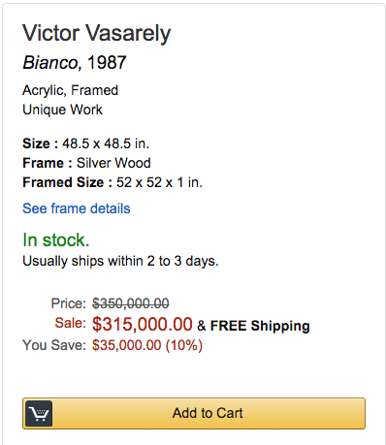
ANOTHER EXAMPLE…

Slide 5
CROSS OUT THE LINE
To delete content: <del> </del>
To insert content: <ins> </ins>

Slide 6
ACTIVITY
A student started school with this mentality but ended up with the following:

